Slide 1
CIS Workshop Scenario
Hyun

Slide 2
Workshop Scenario Overview
AdventureWorks Travel provides concierge services for business travelers.
In an increasingly crowded market, they are always looking for ways to differentiate themselves and provide added value to their corporate customers.
They are looking to pilot a web-app that their internal customer service agents can use to provide additional information useful to the traveler during the flight booking process.
They want to enable their agents to enter in the flight information and produce a prediction as to if the departing flight will encounter a 15 minute or longer delay, taking into account the weather forecasted for the departure hour.
In this workshop, attendees will build an end-to-end solution to predict flight delays taking into account the weather forecast.

Slide 3
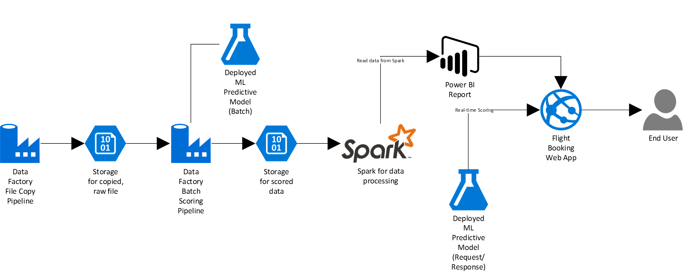
Workshop Architecture
Cortana Intelligence Suite
The goal is to show an end-to-end solution and not necessarily try to work in every component possible. The workshop architecture is below and includes:
Azure ML
Azure Data Factory
Azure Storage
HDInsight Spark
Power BI
Azure App Service

Slide 4
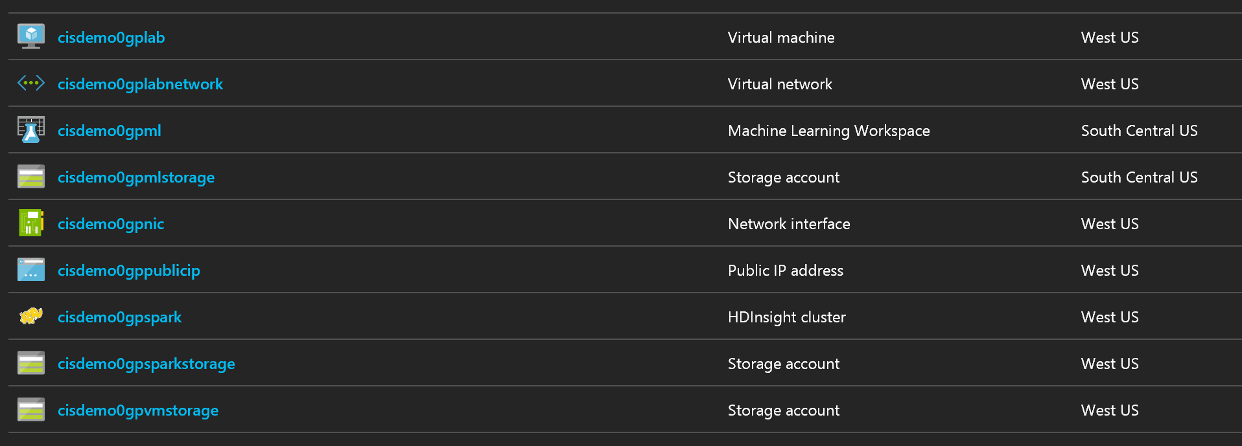
Before you start the workshop
Deploy Workshop Environment to Azure
Visit following link and deploy test/dev environment
Documents and slides are available at github
Provisioning takes 15 minutes BUT you can connect to Virtual Machine during the resource group creating status.
Find a virtual machine and connect to it using following credential
http://bit.ly/2pAsC4n
ID | Password
cortana | Password.1!!

Slide 5
Before you start the workshop
What is happening?

Slide 6
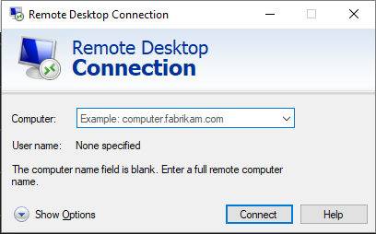
Before you start the workshop
Make sure you are working in the VM you created

Slide 7
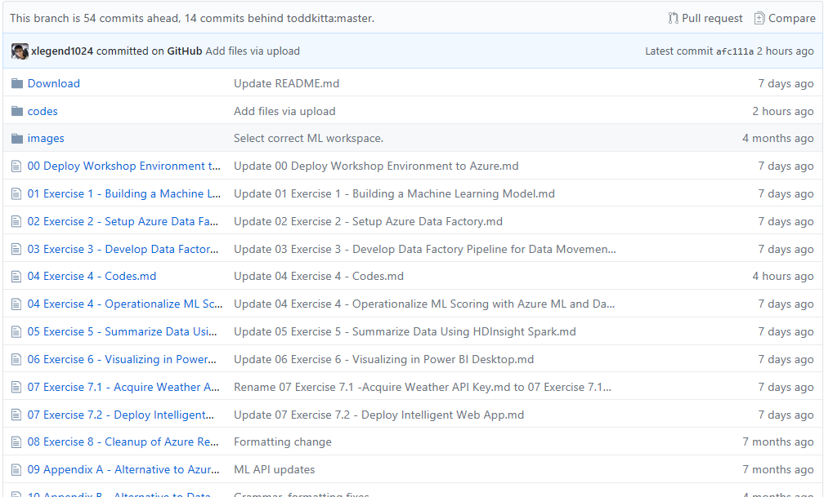
Download Workshop Manual
Make your workshop easy
http://bit.ly/2qtrDHx
User name: cortana
Password: Password.1!!

Slide 8
Ex 1: Building a Machine Learning Model
What you will see next.

Slide 9
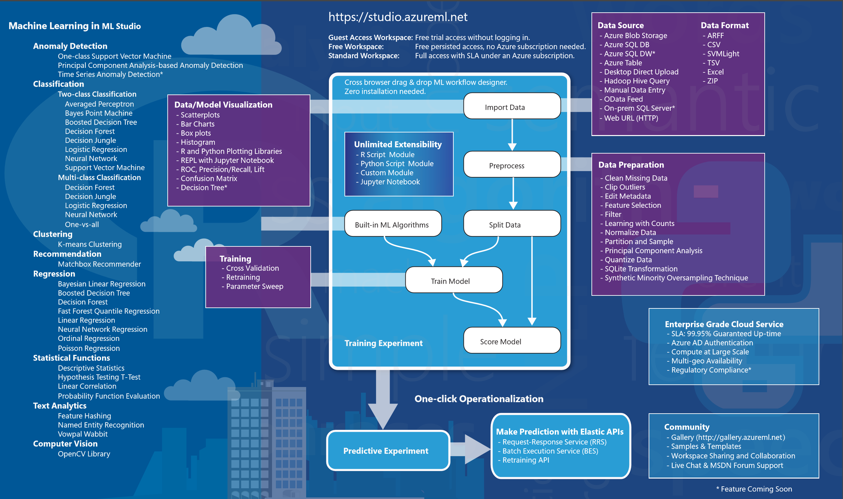
Azure Machine Learning Studio

Slide 10
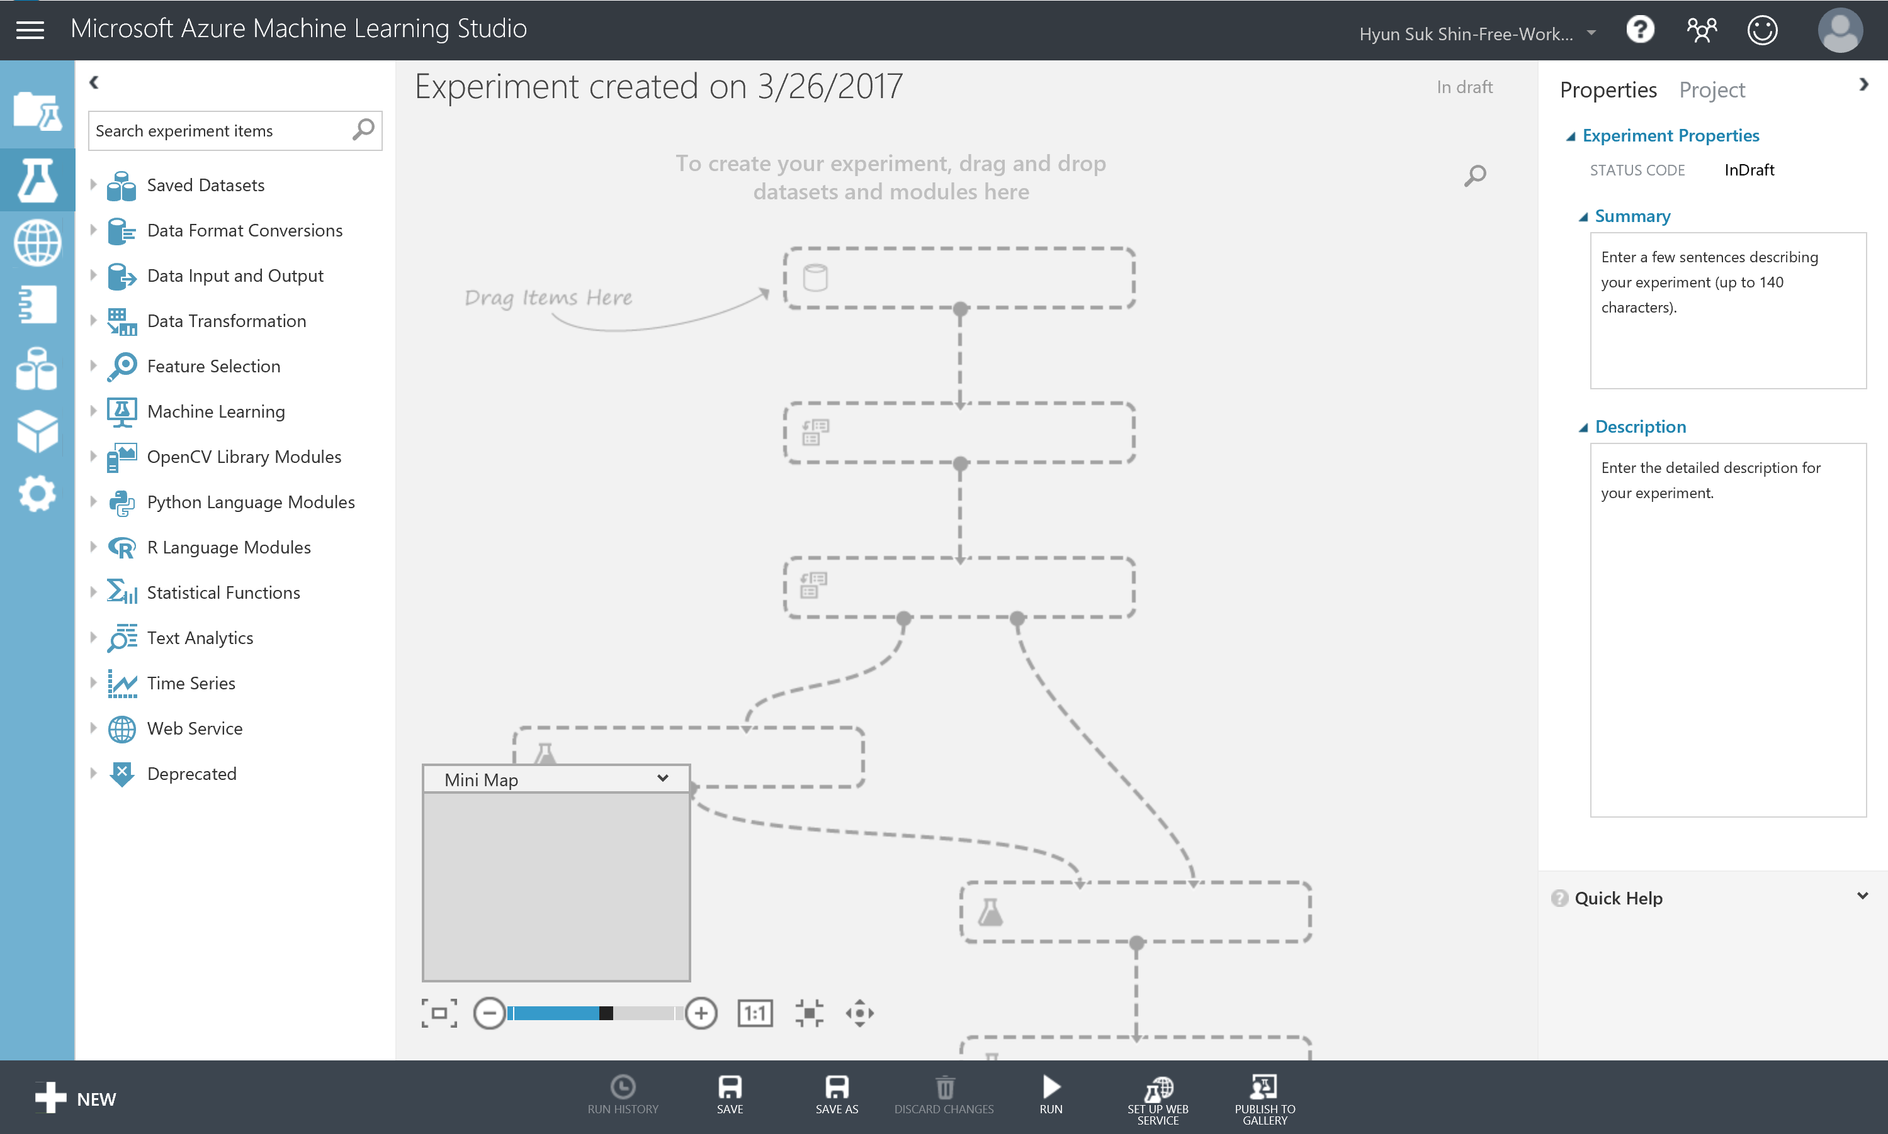
Azure Machine Learning Studio

Slide 11
Exercise 1: Building a Machine Learning Model
Understanding Flight Delays Data Set
A flight is counted as on time if it operated less than 15 minutes later the scheduled time shown in the carriers' Computerized Reservations Systems (CRS). Source: Bureau of Transportation Statistics.
Before start implementing this experiment
Departure or Arrival Date is in HHMM format. So to round any the closest hour, we will divide it by 100 and then round the result (using floor() math operation) to get the integer number of a given number. For example: 1135. We will apply divide op.: (1135/100) = 11.35, then round op. using Floor(11.35) = 11.
Categorical Variables are those that represent a fixed number of possible values, rather than a continuous number. In this experiment, the columns Carrier, OriginAirportID, and DestAirportID represent categorical attributes.
Binning or grouping data (some time called quantization) is an important tool in preparing numeric data for machine learning. In this experiment, we are using group data into bins using Quantiles binning mode. Quantiles is also known as equal Hight binning. This applies to all numeric values in selected flight delays dataset.
In this experiment, we used sweep parameters (Tune Model Hyperparameter): Performs a parameter sweep on a model to determine the optimum parameter settings.

Slide 12
Ex 2: Setup Azure Data Factory

Slide 13
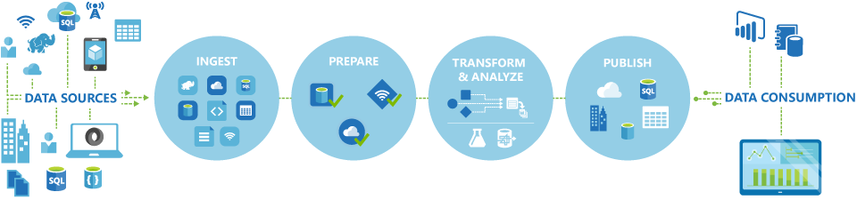
Azure Data Factory
Automates the movement and transformation of data
Create, schedule, orchestrate, and manage data pipelines
Visualize data lineage
Connect to on-premises and cloud data sources
Monitor data pipeline health
Automate cloud resource management
Move relational data for Hadoop processing
Transform with Hive, Pig, or custom code

Slide 14

Azure Data Factory
Automates the movement and transformation of data
Create, schedule, orchestrate, and manage data pipelines
Visualize data lineage
Connect to on-premises and cloud data sources
Monitor data pipeline health
Automate cloud resource management
Move relational data for Hadoop processing
Transform with Hive, Pig, or custom code

Slide 15
Ex 3: Develop Data Factory Pipeline for Data Movement

Slide 16





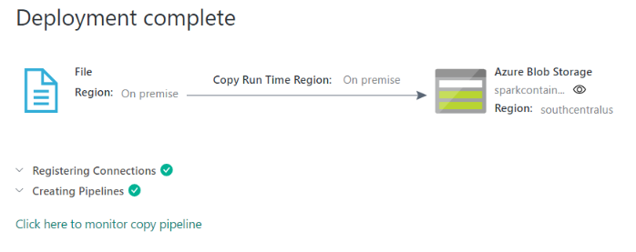
Move Data
Copy on-premises data to cloud
Data Factory
Pipeline
Data
Movement
Gateway
Files
Firewall
Files

Slide 17
Ex 4: Operationalize ML Scoring with Azure ML and Data Factory

Slide 18
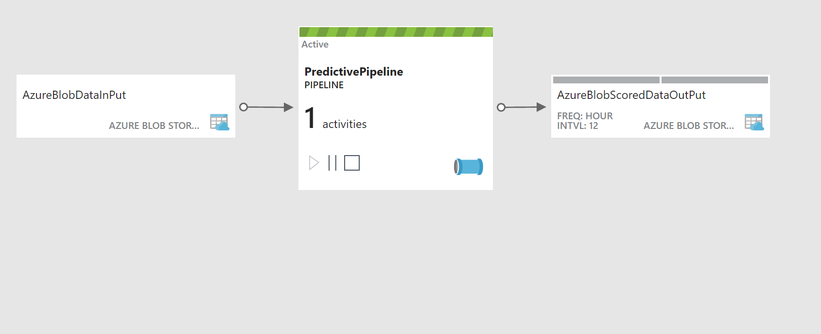
Transform Data
Scoring data using Azure Machine Learning
Data Factory
Pipeline
Files
Files
Data
Movement
Gateway

Slide 19
Ex 5: Summarize Data Using HDInsight Spark
What you will see next.

Slide 20
Ex 5: Summarize Data Using HDInsight Spark
User name: cortana
Password: Password.1!!

Slide 21
Ex 6: Visualizing in Power BI Desktop
What you will see next.

Slide 22
7.1 Acquire Weather Underground API Key
What you will see next.

Slide 23
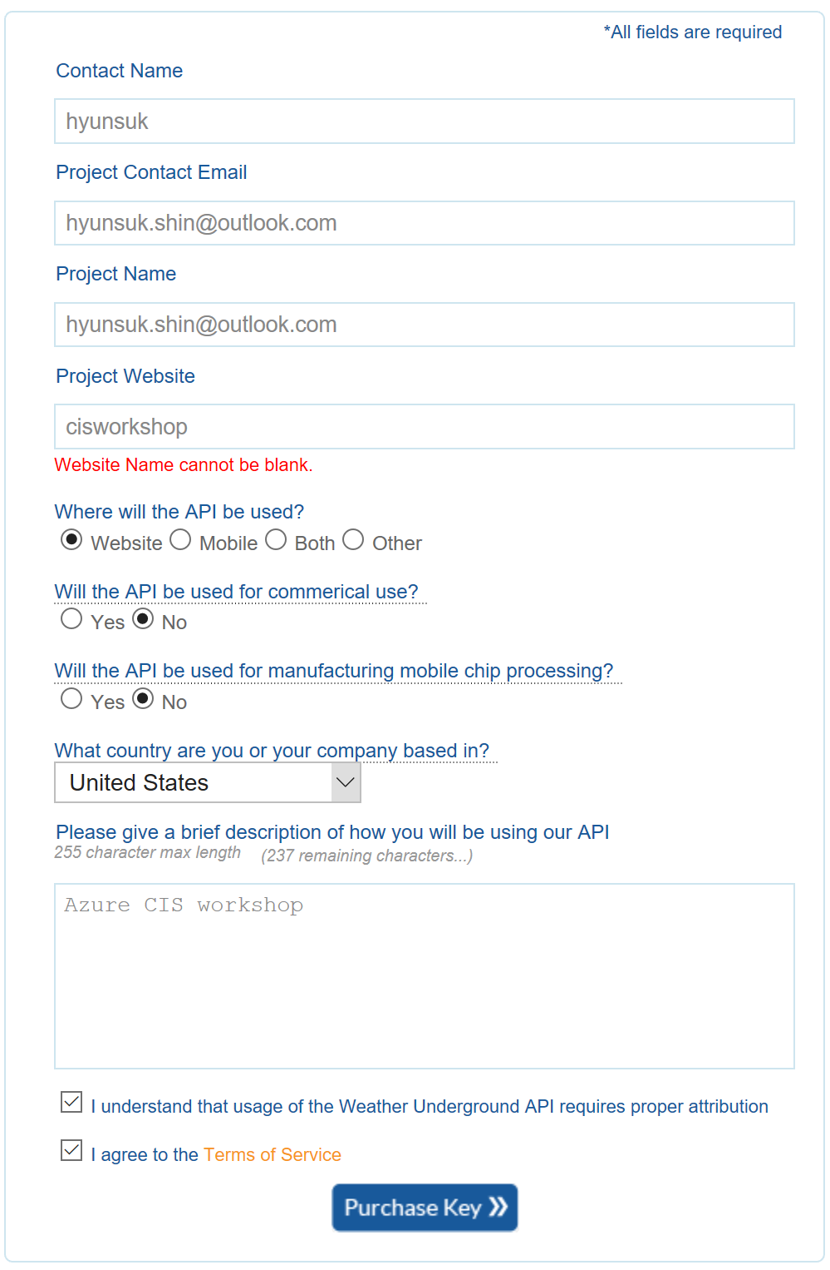
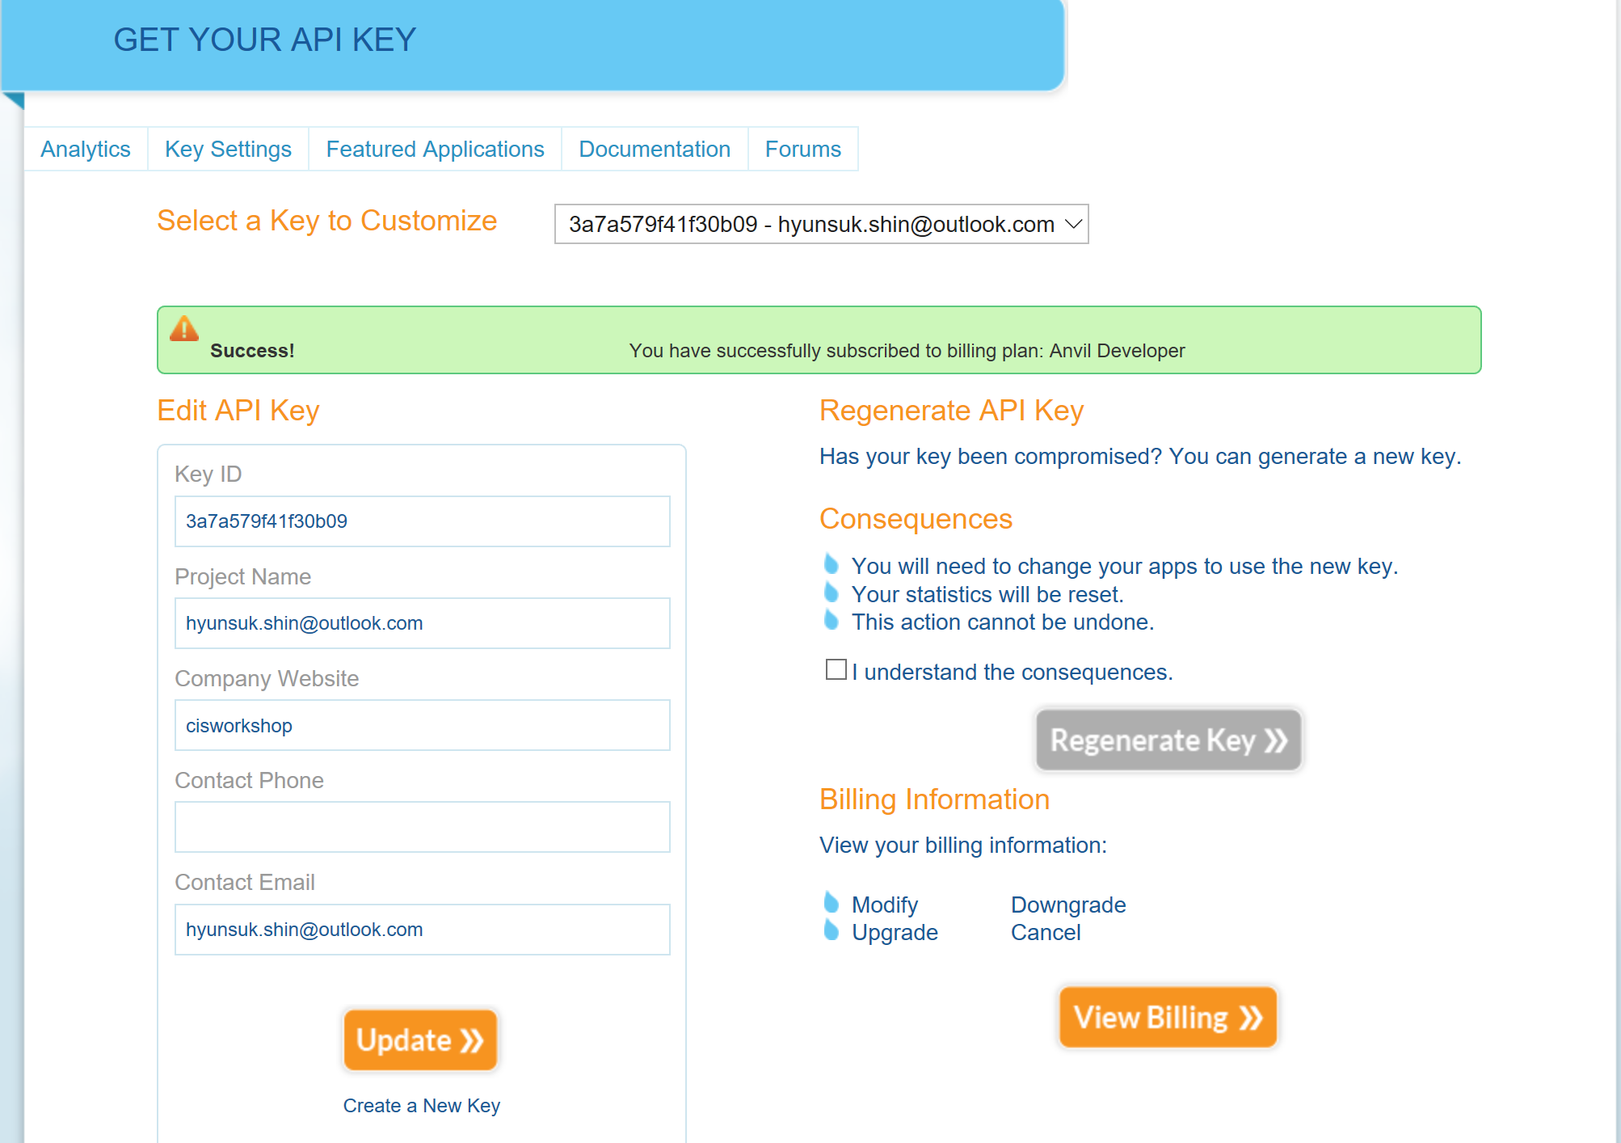
7.1 Acquire Weather Underground API Key
http://api.wunderground.com/api/3a7a579f41f30b09 /forecast10day/q/WA/SEA.json

Slide 24
Ex 7.2: Deploy Intelligent Web App
What you will see next.

